Slide 1
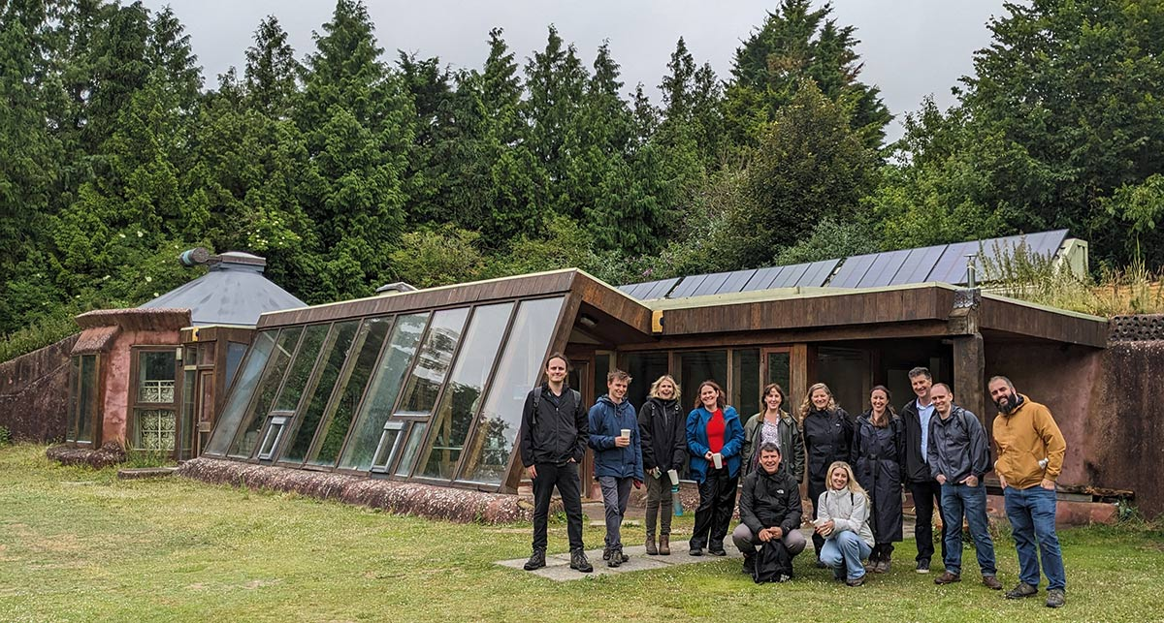

People participation in the future of energy
Ollie Pendered
Chief Executive Community Energy Pathways
Ollie.Pendered@communityenergypathways.org.uk

Slide 2
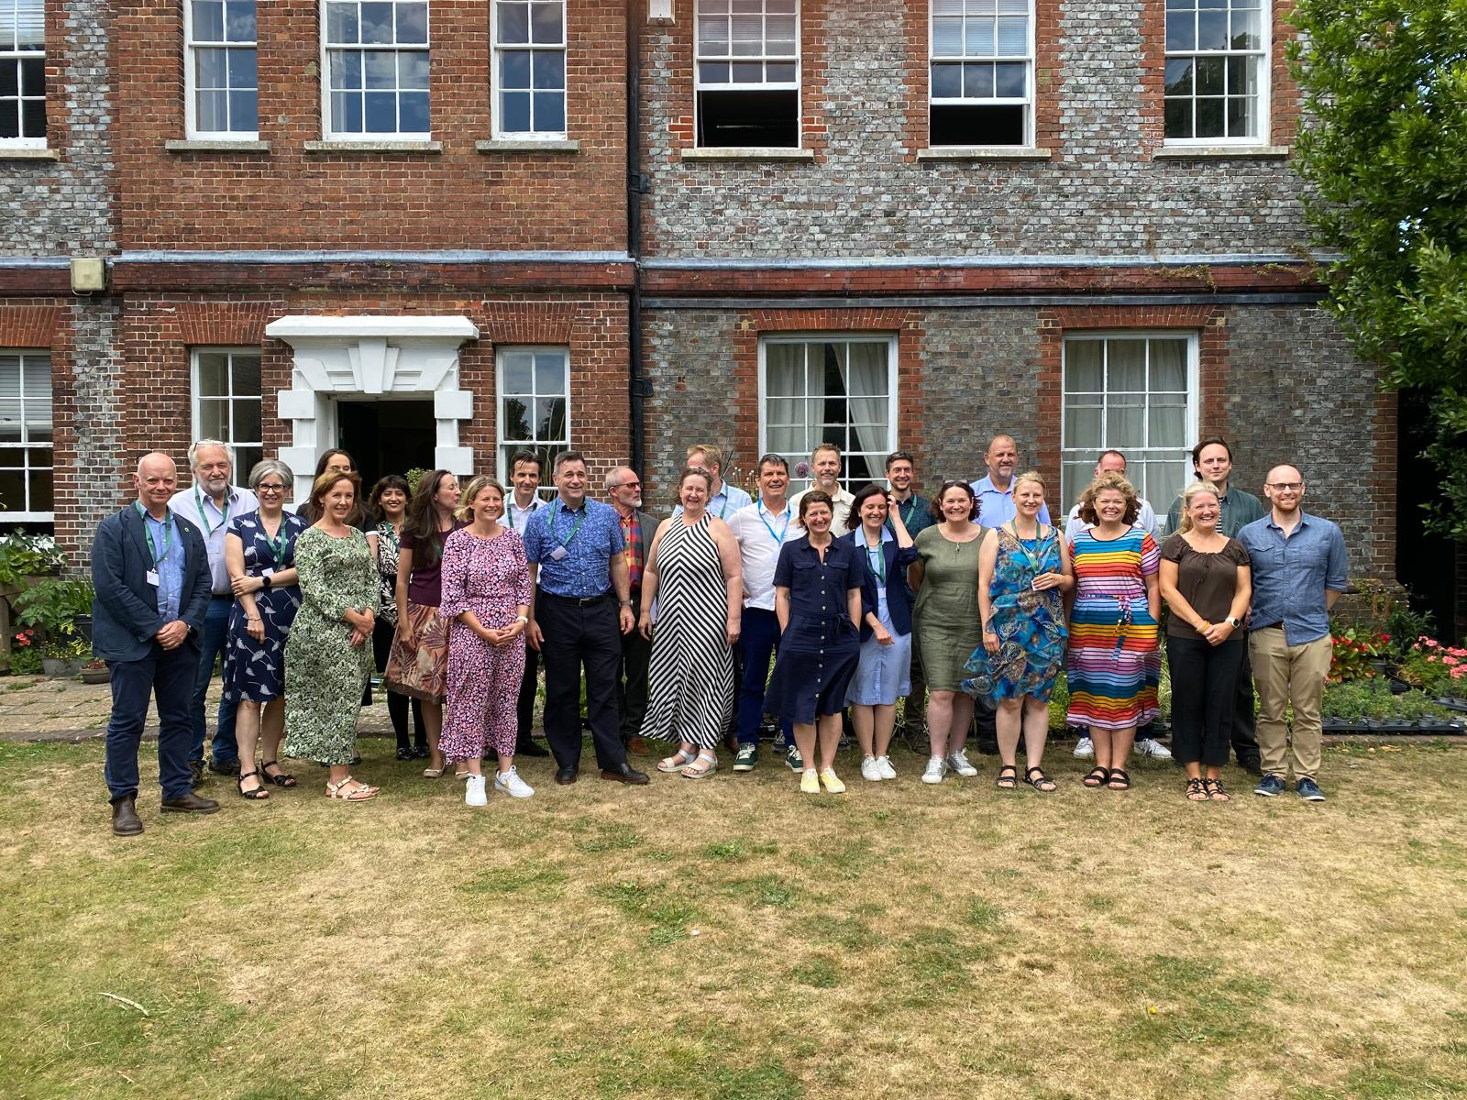
Collaborating and convening
People Participation in the future of Energy
Consumer
Community
Local
Narratives that inform policy
Powering Up
Powering Down
Capacity building

Slide 3
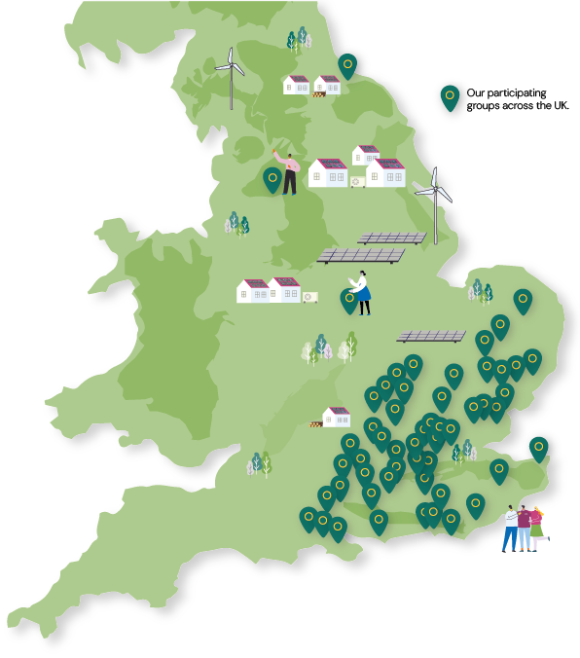

Our Reach 2025
On average, we provide over 30 days intensive consultancy at a local level for each CE group that we support.
24,000 advice sessions in past 18 months in community events and 1,200 home visits
100 local energy champions trained in 12 months
50 +
Community Energy
Groups
15
Local
authorities
100+
Champions trained

Slide 4
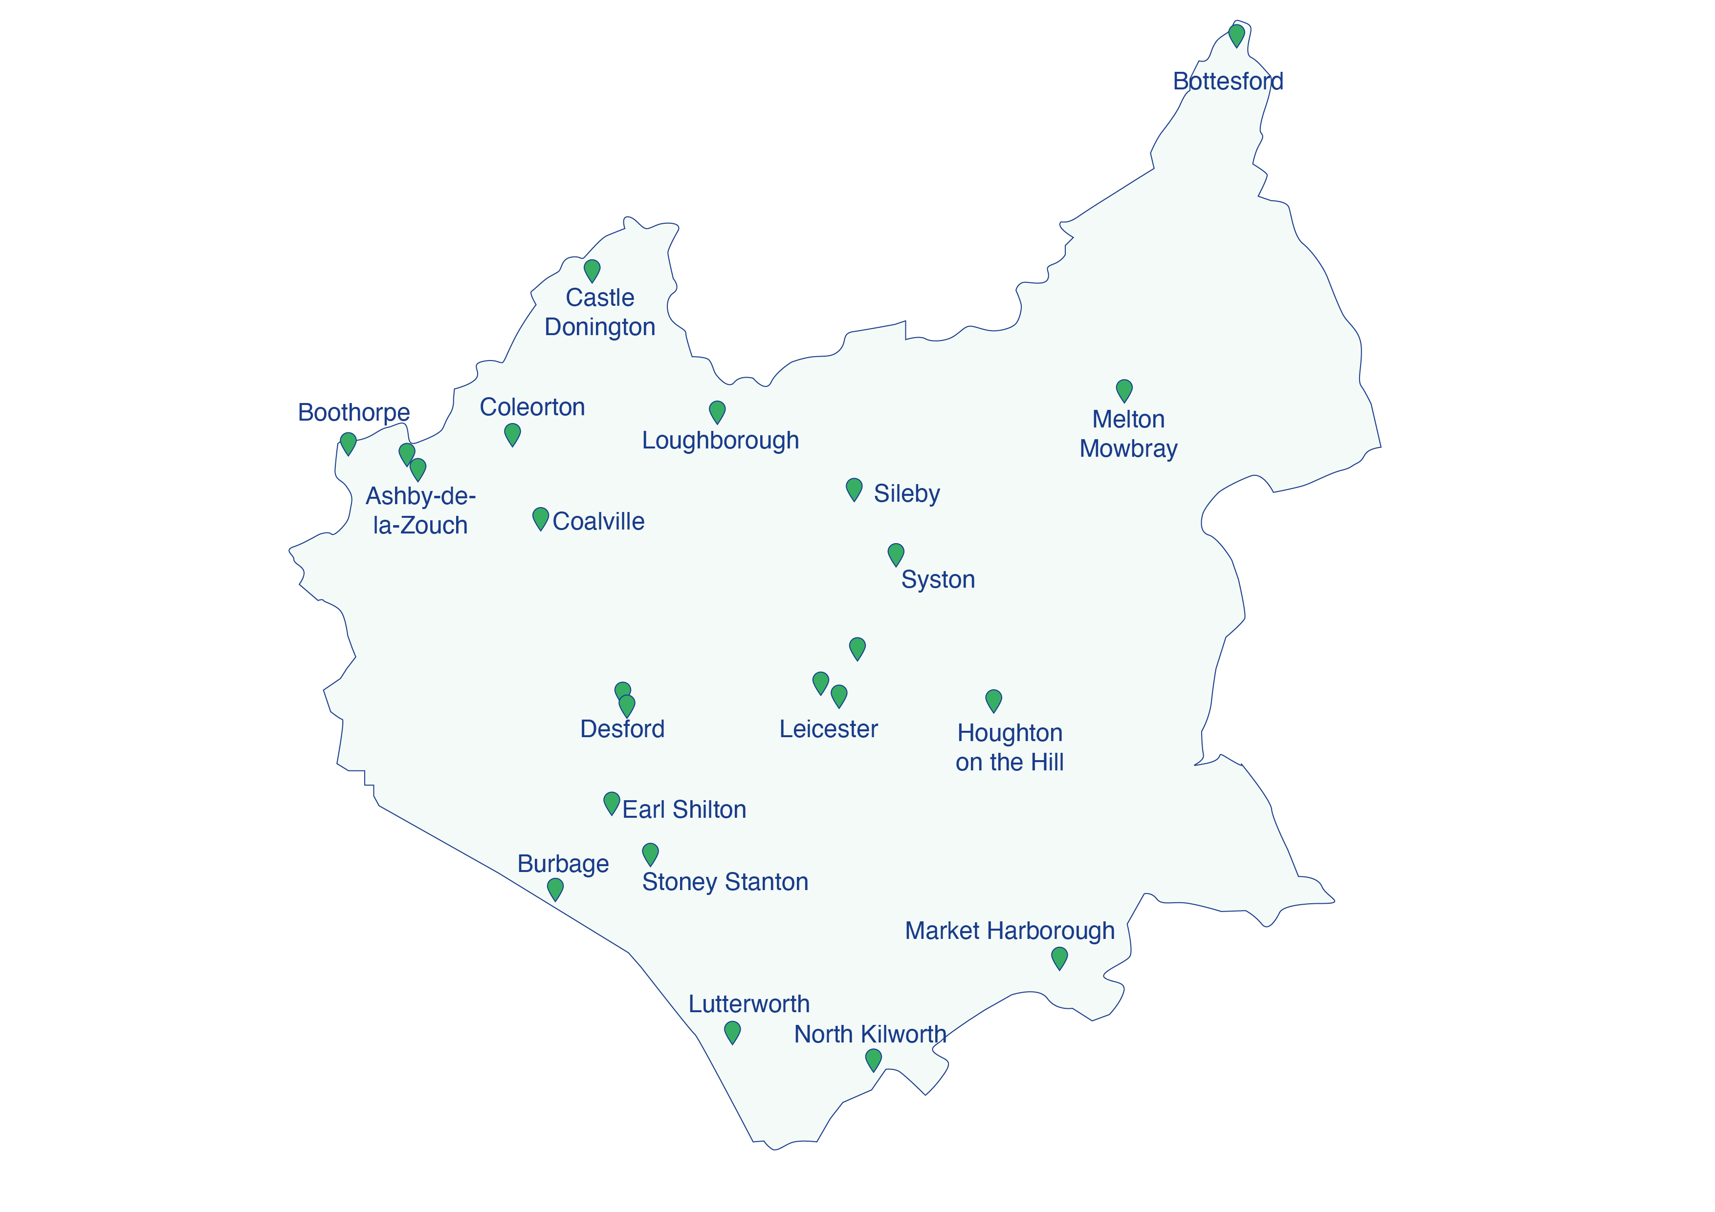

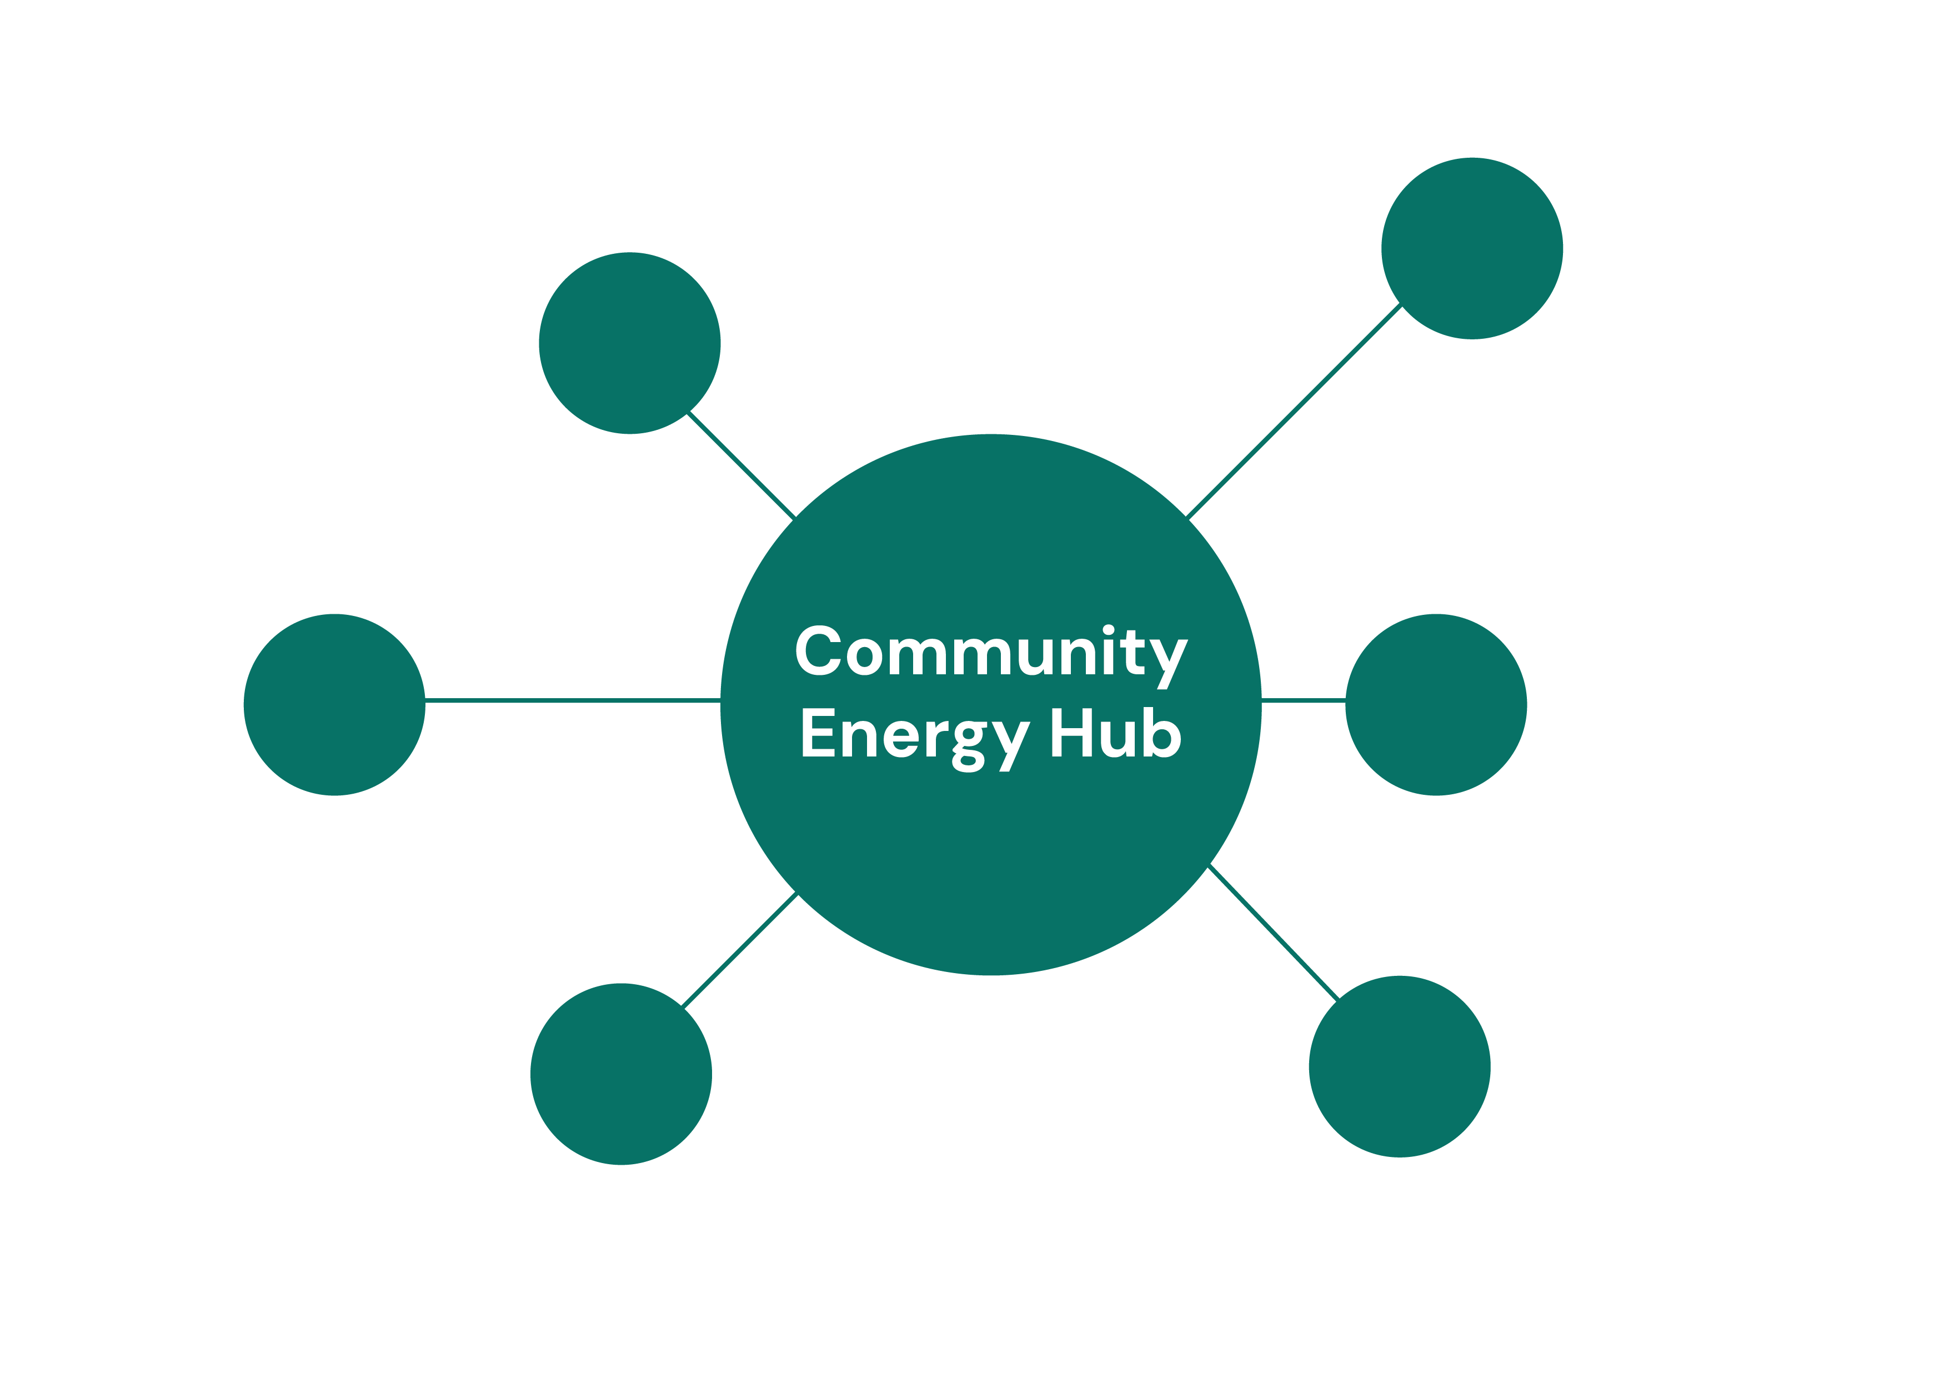
Community Energy hub model

Slide 5
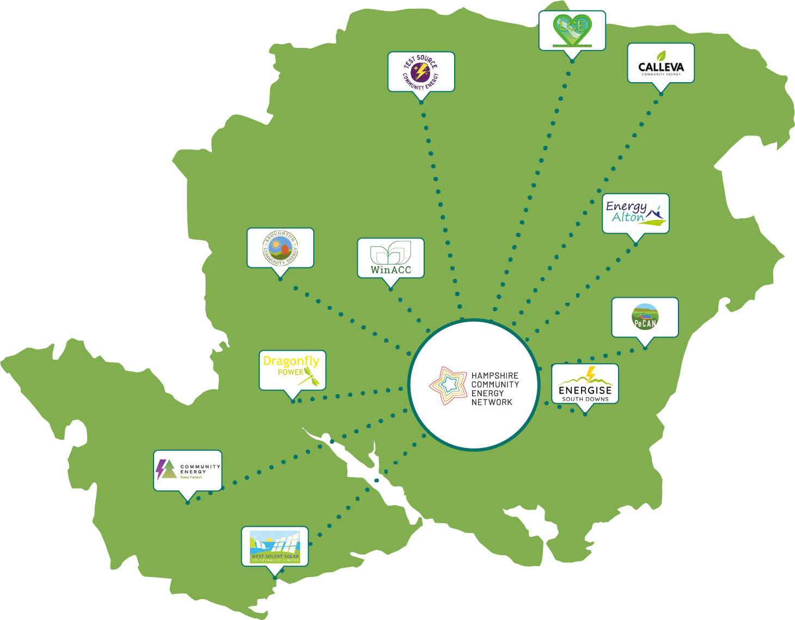

Hampshire Community Energy Network
Example of one of Community Energy Pathways’ established networks

Slide 6
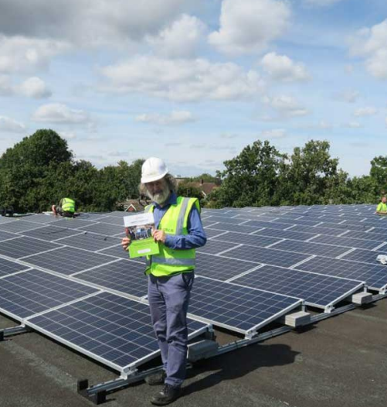

Ouse Valley Energy Services Coop (OVESCo)
Harveys Brewery – rooftop PV 98kW
Sunny Solar Schools
Ouse Valley Solar Farm – 17 MW with no subsidy!
Meadow Blue Solar Farm – 5MW
Get Bikery – electric cargo bike hire/delivery
2m Climate Action Fund
Energy advice reaching 2000 homes/yr
www.ovesco.co.uk

Slide 7
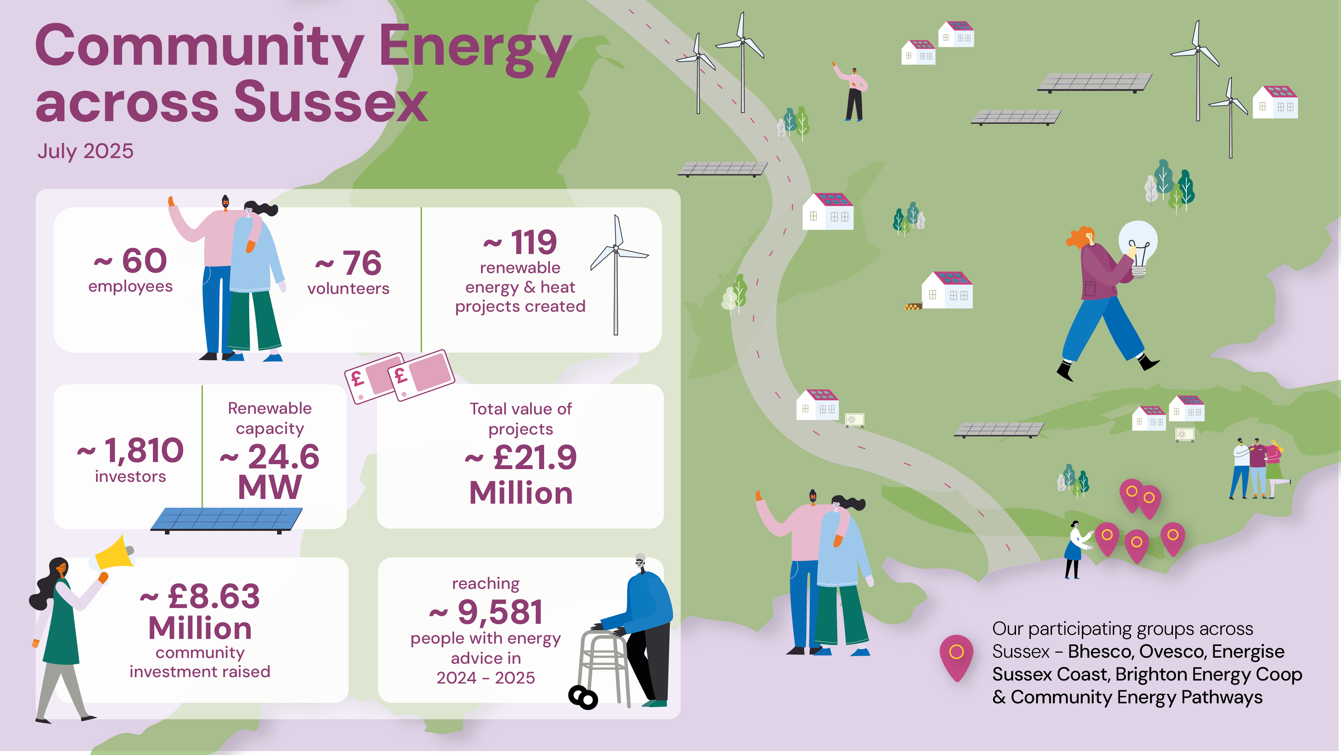

Slide 8
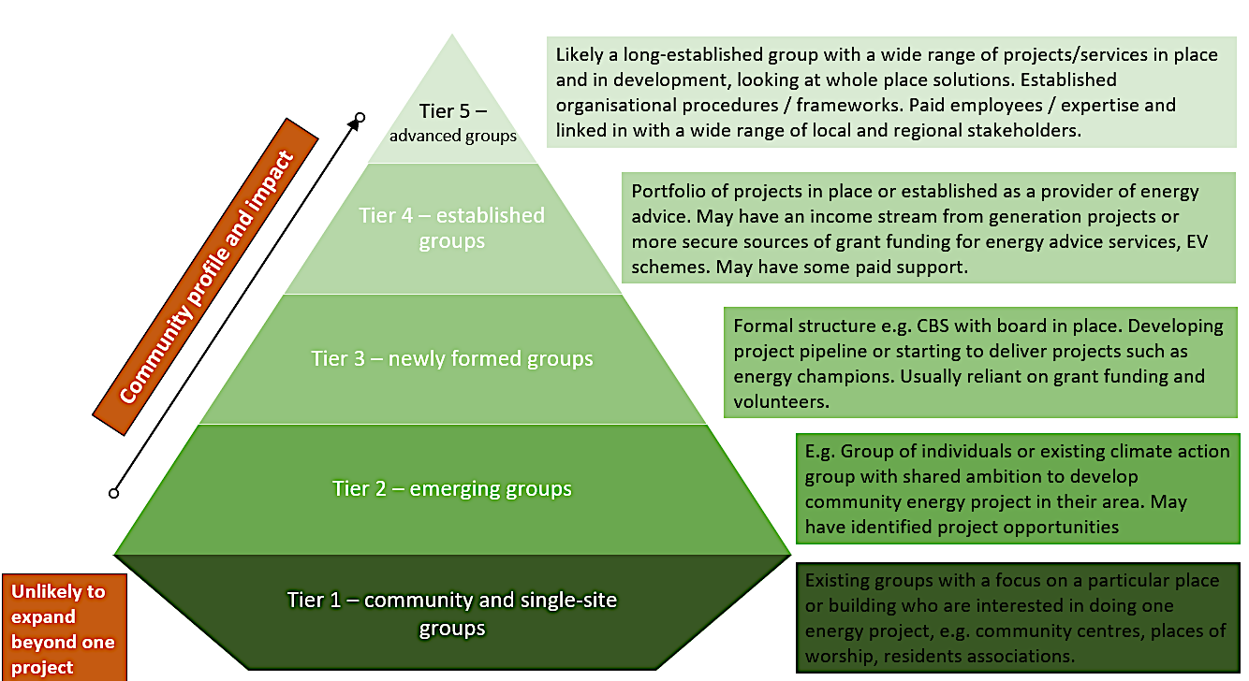
Existing groups with a focus on a particular place or building who are interested in doing one energy project, e.g. community centres, places of worship, residents associations

Slide 9
Pathways to net zero with community energy
Top down
EMBEDDED
PRINCIPLES
Accountability and ownership
Resource and capacity
Communications and information
Transparency on key stakeholders
Engagement with neighbourhoods and communities
Coordination and collaboration
Local Authority net zero strategies/Local Area Energy Plans
Align with LA departments using embedded principles - local/neighbourhood/transport/economic development and health plans etc
Place based decision making
NET ZERO TOGETHER
Public finance
Community finance
Attracting grants
Innovation
Public participation
Consultation
Community support
Resilience
Established community energy network within a local authority area
Bottom up

Slide 10
Social Value Portal
NT1 – Local People employed
NT76 – Unemployed people recruited
NT6 – Disabled People recruited
MW of renewable energy generation
NT9 – Accredited training for new staff
Selected TOMs
kWh saving through energy advice
Multiple tools exist for measuring SV
We have been trialling using the Social Value Portal due to its wide use and understanding in the procurement world
SVP uses the national TOMs (Themes, Outcomes, Measures) to generate proxy values for a range of activities that generate social value
Focus on added social value above and beyond an organisation’s core business
NT80 – Upskilling existing employees with accredited training
NT10 – Employment of new apprentices
NT81 – Upskilling existing employees through apprenticeships
kWh saved through retrofit projects
NT52 – Initiatives to promote resilient communities
NT29 – Volunteering in the local community
NT53 – Initiatives to protect the environment
Theme
Work
Economy
Community
Planet
Bespoke KPI

Slide 11
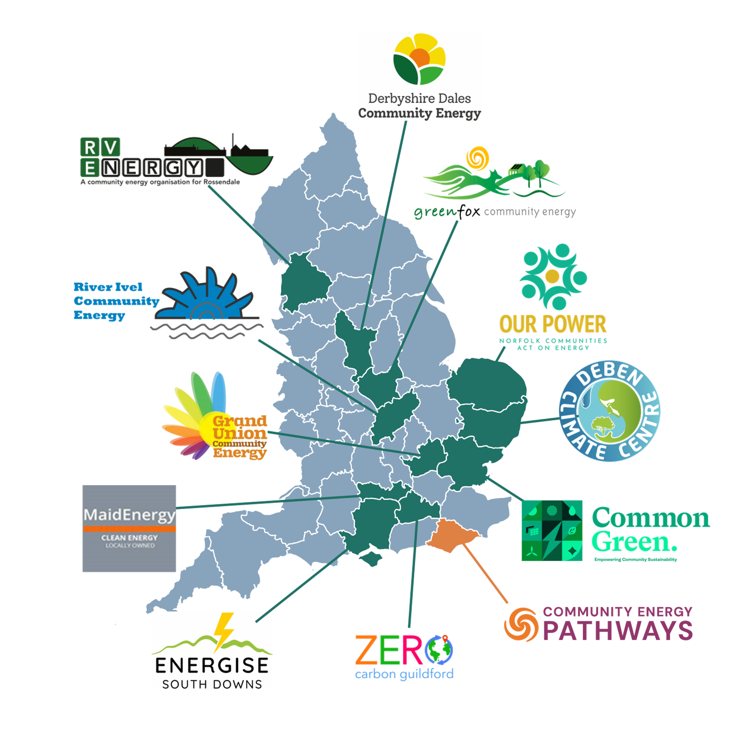
Community Energy People
Bringing people power to community energy!
Aims:
Grow the capacity of CE groups by supporting them to employ staff for the first time
Address the desperate need for core funding
Create local opportunities for people to get involved with the energy sector through employment and volunteering
Promote diversity and inclusion in the sector

Slide 12
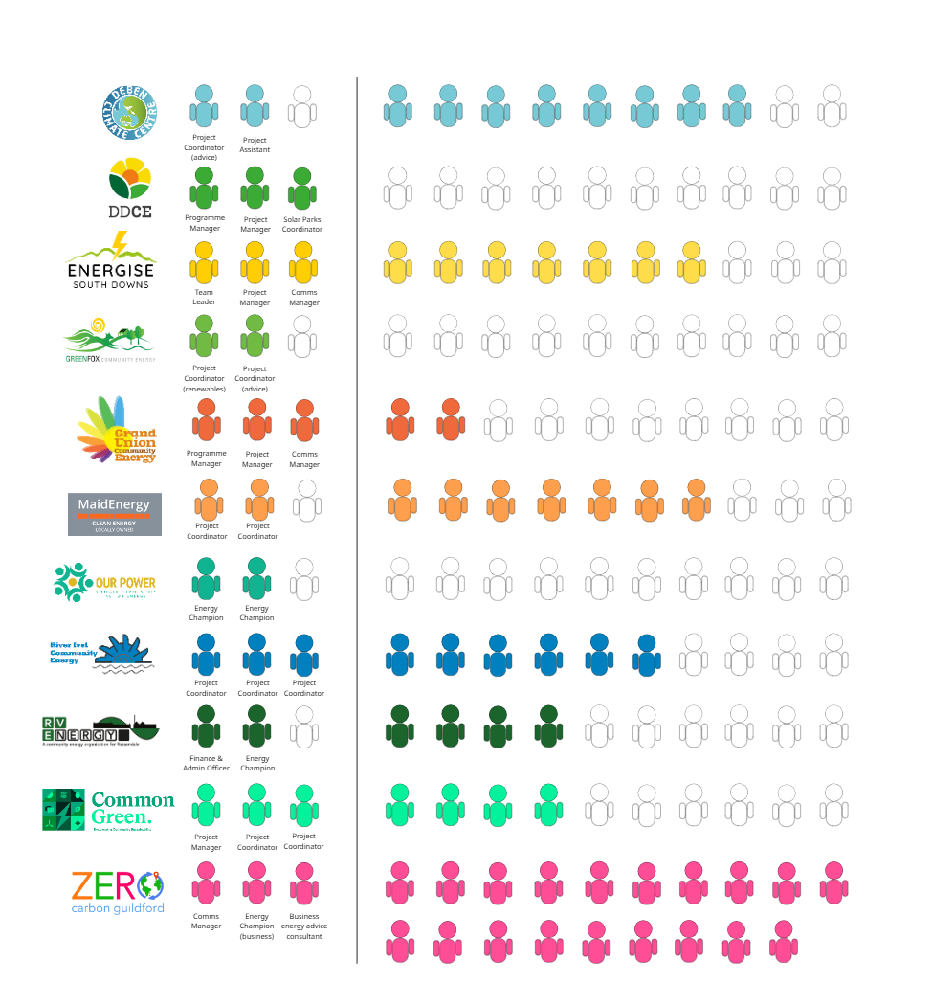
Staff
Volunteers

Slide 13
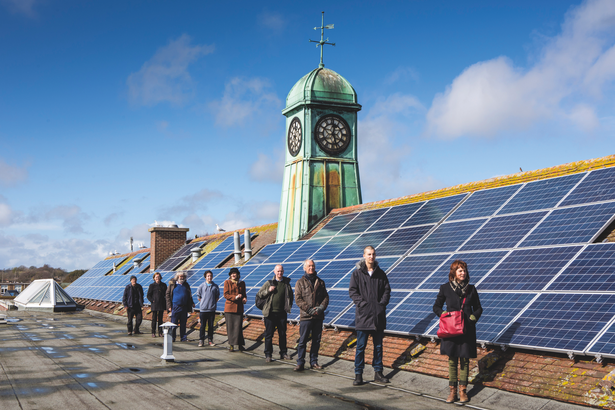
Powering Up
We support community groups and local authorities to develop feasible locally owned renewable energy projects. We support community engagement, planning, funding and development.
Shared ownership model of renewable energy between developers and local communities is fast becoming a reality. We bring together communities and commercial wind, solar and battery developers to jointly develop and finance projects. Communities get a share of renewables in their back yard; developers get to unlock complex projects.

Slide 14
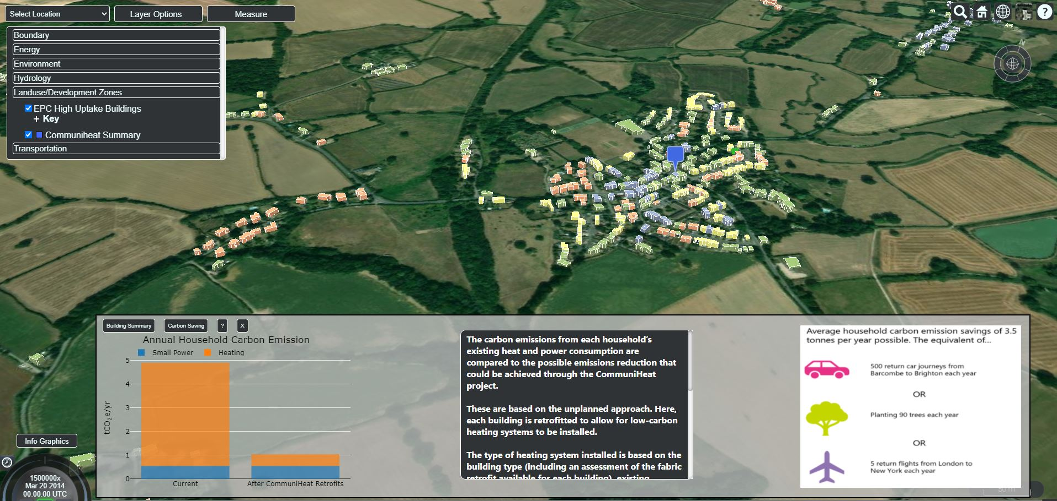
Parish level plans
CommuniHeat
East Sussex Pilot – a planned approach to community decarbonisation
500 heat pumps installed
17 renewable sites
Retrofits
75% saving in network reinforcement costs

Slide 15
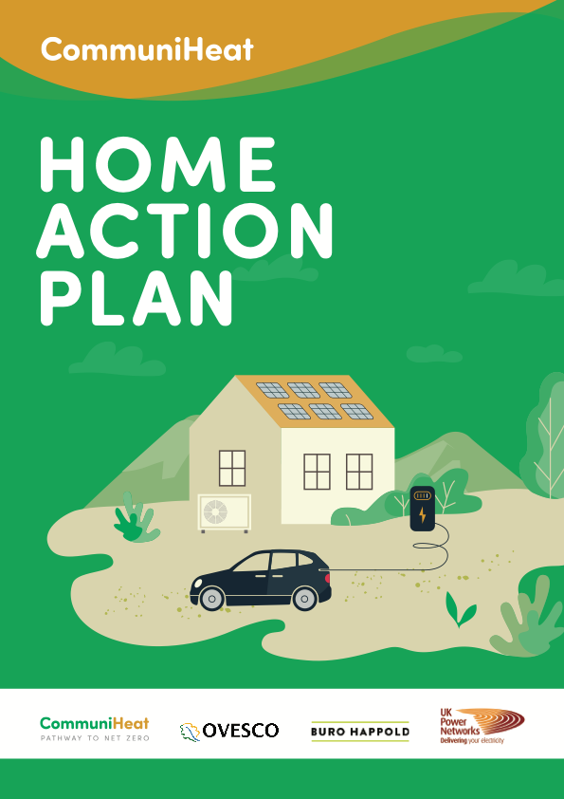
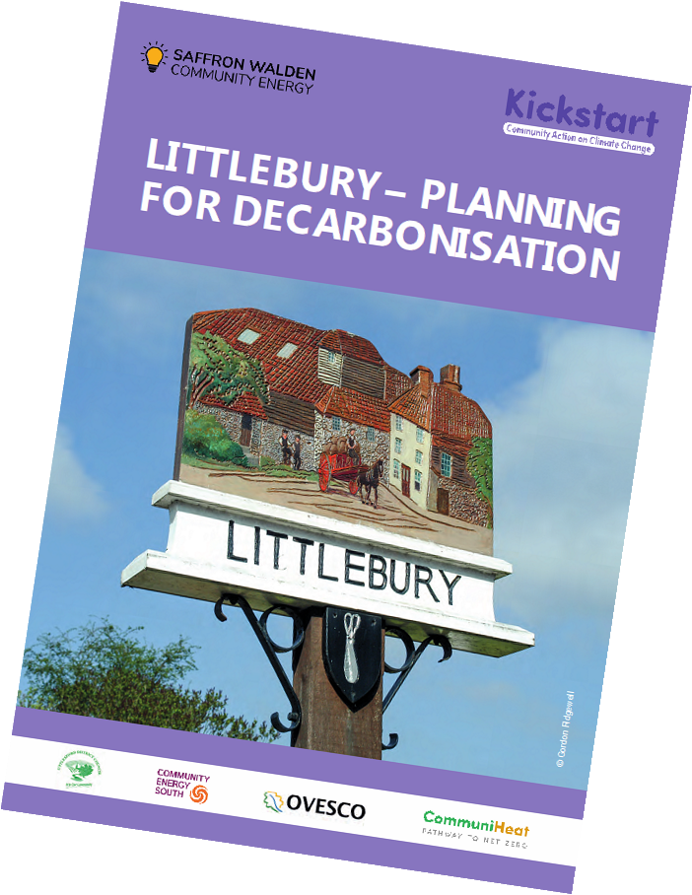
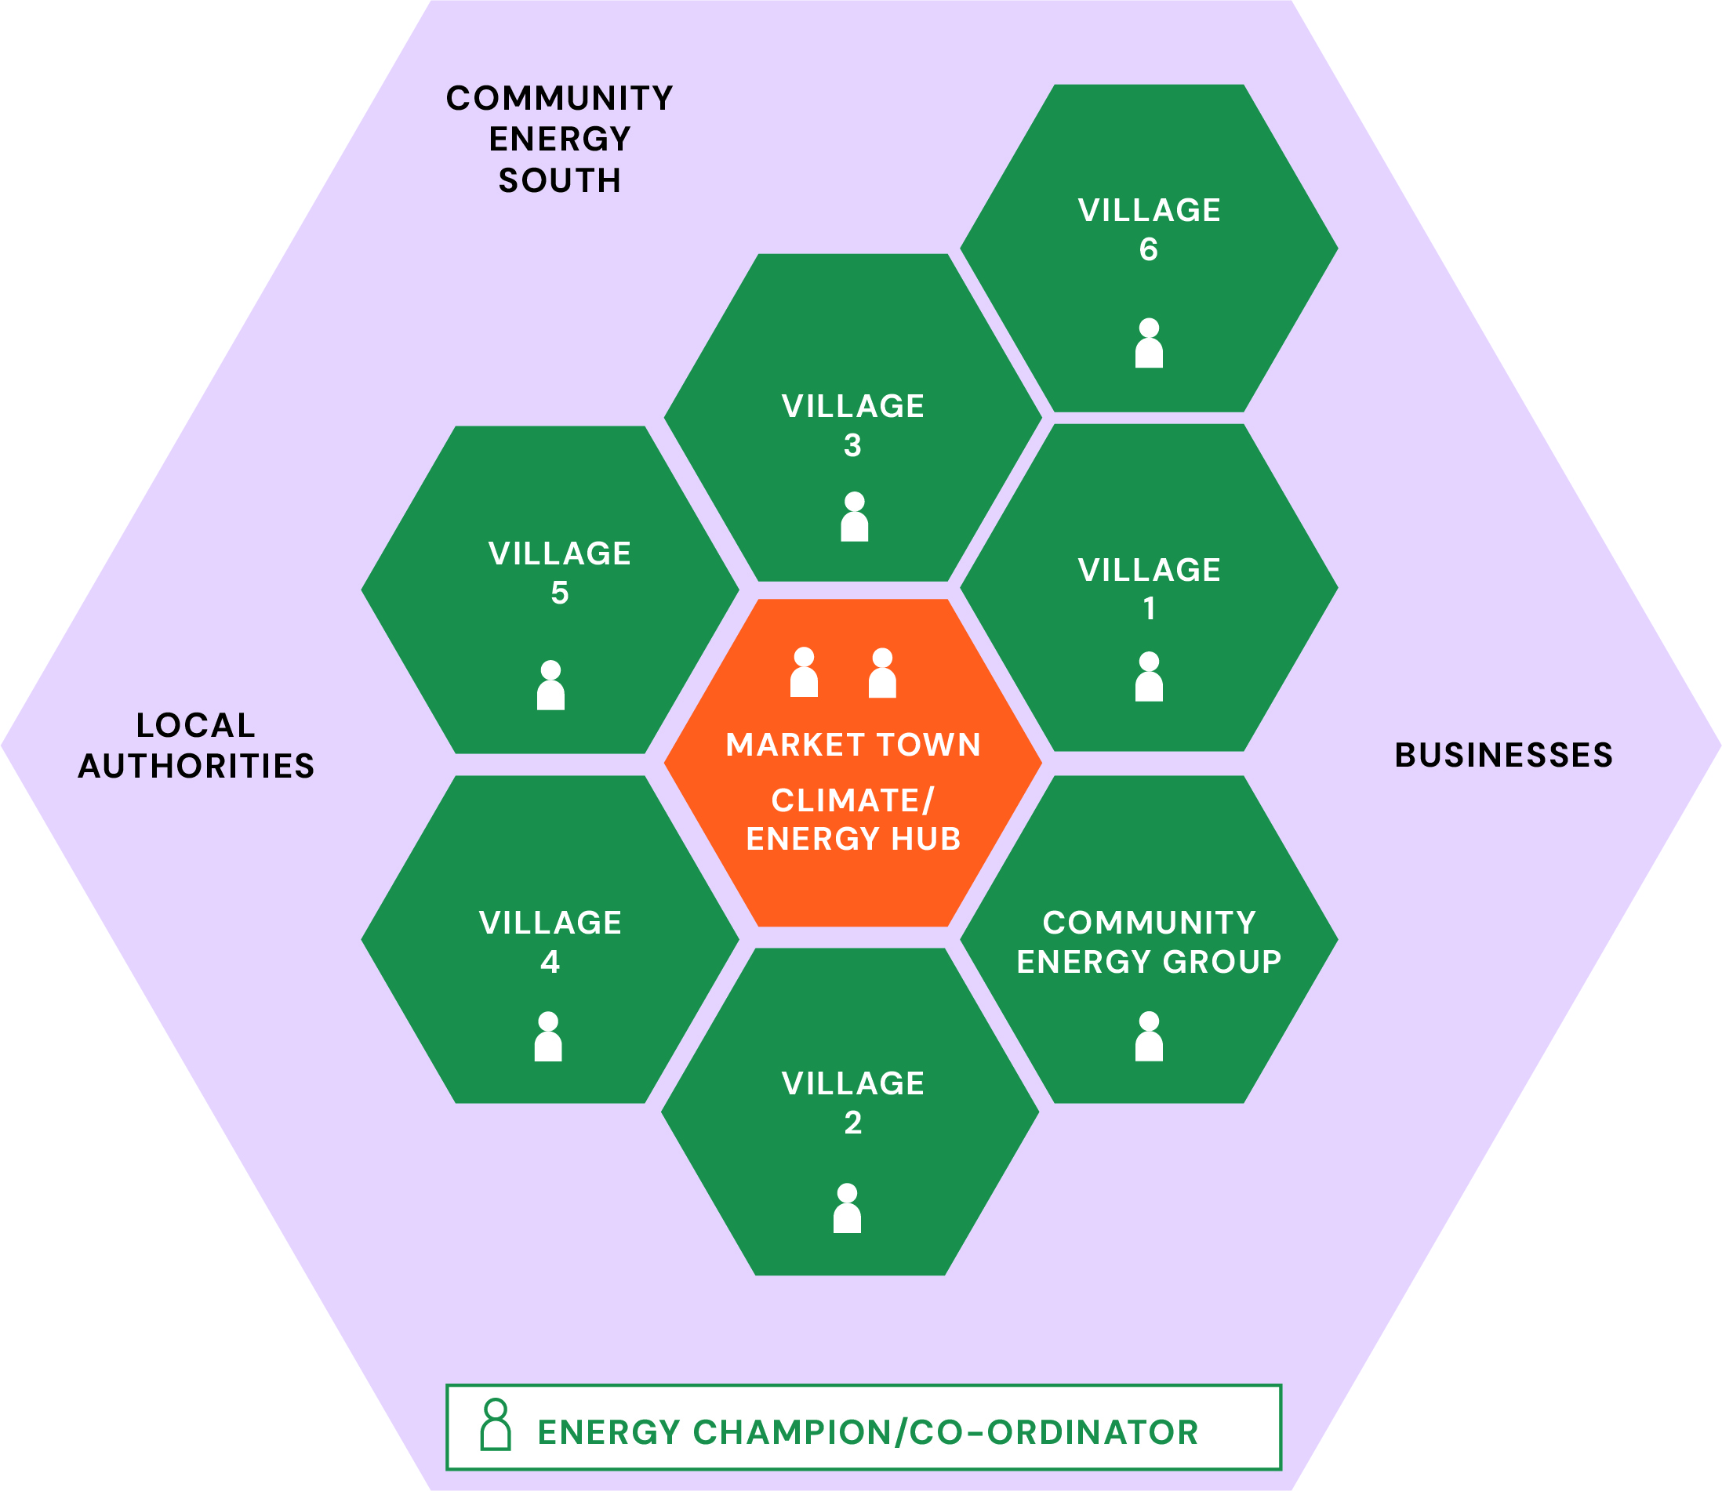
Community Planning
For Local Area Energy Plans (LAEP) to be a success, community buy-in and deployment is essential.
Our community led decarbonisation plans complement LEAPs and position local communities to deliver well informed, actionable steps in the transition to net zero.
The plans combine community engagement, data gathering, project scoping and industry partnerships, supported by expert support.

Slide 16

Riding Sunbeams
Powering our railways with community solar PV
Leo Murray
CEO
leo.murray@ridingsunbeams.org
JUNE 2025
COMMERCIAL IN CONFIDENCE

Slide 17
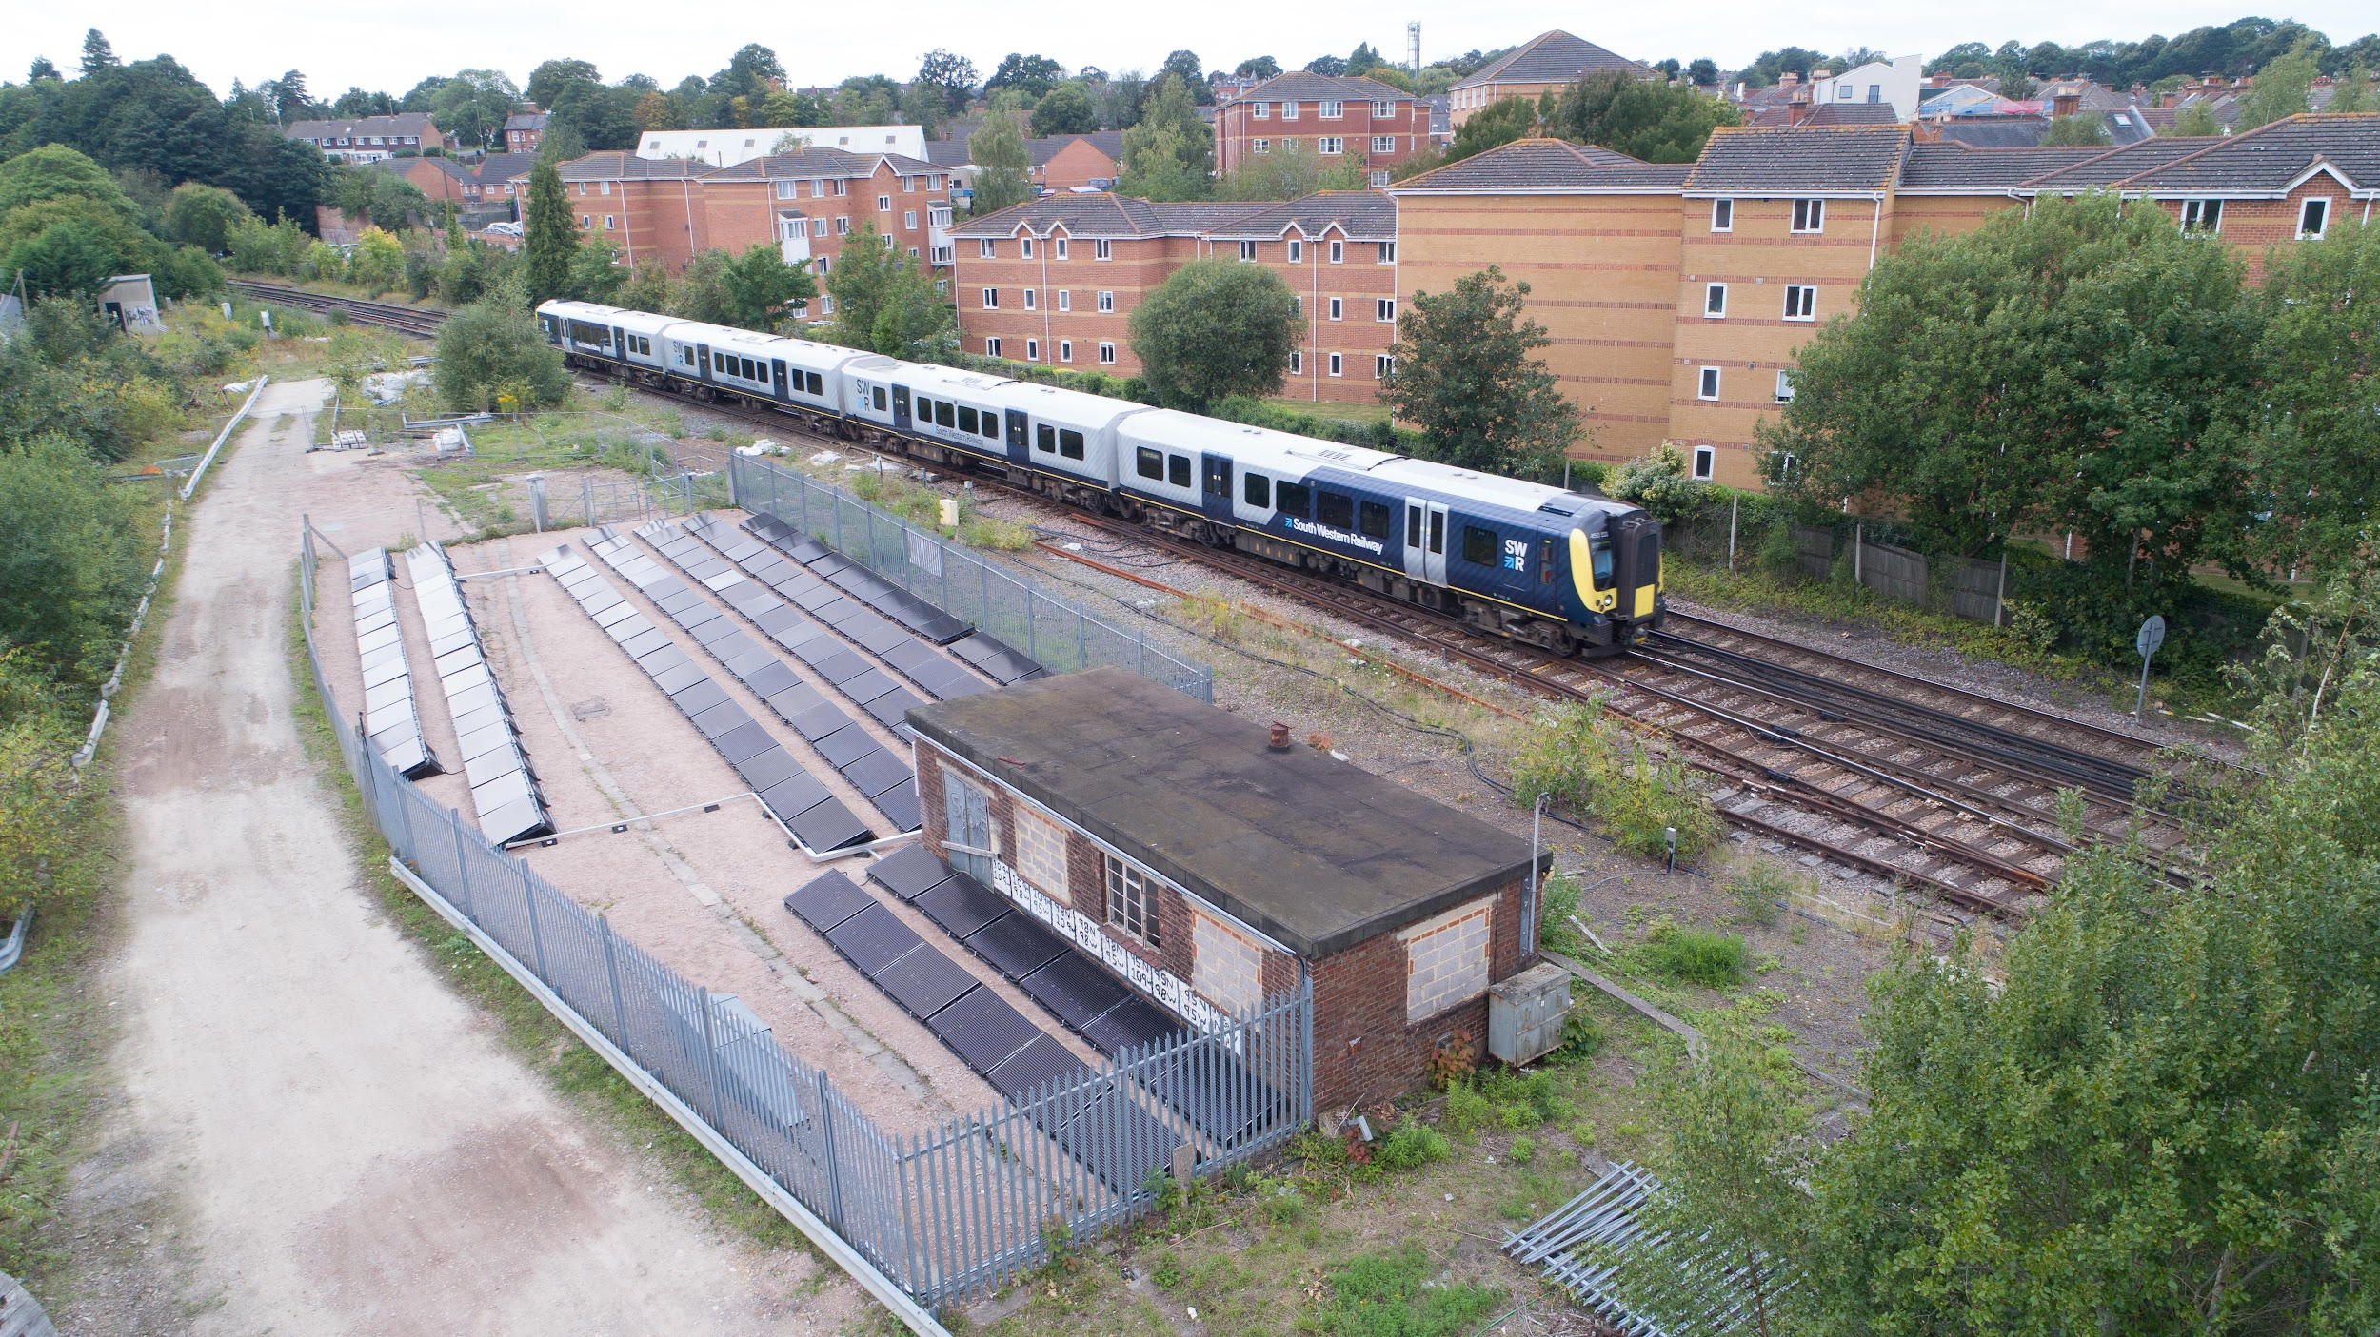
Over the last six years Riding Sunbeams has pioneered the direct connection of solar PV generation to electrified rail networks to power trains.
Our world first 2019 DC demonstrator project (‘First Light’) at Aldershot in Hampshire has led to the creation of a brand new market in direct wire solar traction energy supply in the UK, with the first commercial procurement processes underway now.
Notes:
To hold dissemination events and produce materials for industry to understand the learnings
Build a demonstrator site to prove the connection methodology using existing technology
To the develop and test an economically attractive means of conversion in live operational environment and to obtain Network Rail type approval
To develop the pipeline of sites in readiness for the electrification

Slide 18
Our recipe for community energy sector support
Community Energy Strategy
We work closely with Local Authorities and existing community groups to understand how developed the community energy sector is in an area and what is needed to grow its scale and impact.
Identifying potential for energy advice services to be supported to grow.
Capacity Building
A structured programme that includes expert community energy training, skills development mentoring, business planning, governance and fundraising support.
We create the foundations of a local community energy network, bringing together and developing skills and knowledge of action groups, councils, and local experts.
Development of energy advice service capability.
Energy Planning
Our community led decarbonisation plans complement LEAPs and position local communities to deliver well informed, clear, actionable steps in the transition to net zero.
Energy advice supports gathering data and community engagement.
Powering
Down
Community scale mobilisation of community energy champions who provide trusted and impartial local advice on energy and cost savings.
Energy advice supports the development of community energy groups, development of local retrofit markets and creation of green jobs.
Powering
Up
Development support for advanced groups working on heat networks, renewable energy and low carbon transport.
These groups have usually started off with building local presence and network through energy advice.

Slide 19

People participation in the future of energy
Ollie Pendered
Chief Executive Community Energy Pathways
Ollie.Pendered@communityenergypathways.org.uk

