Slide 1
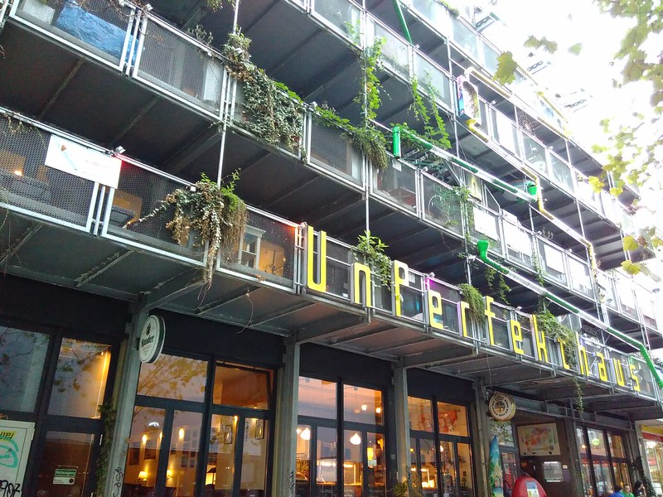
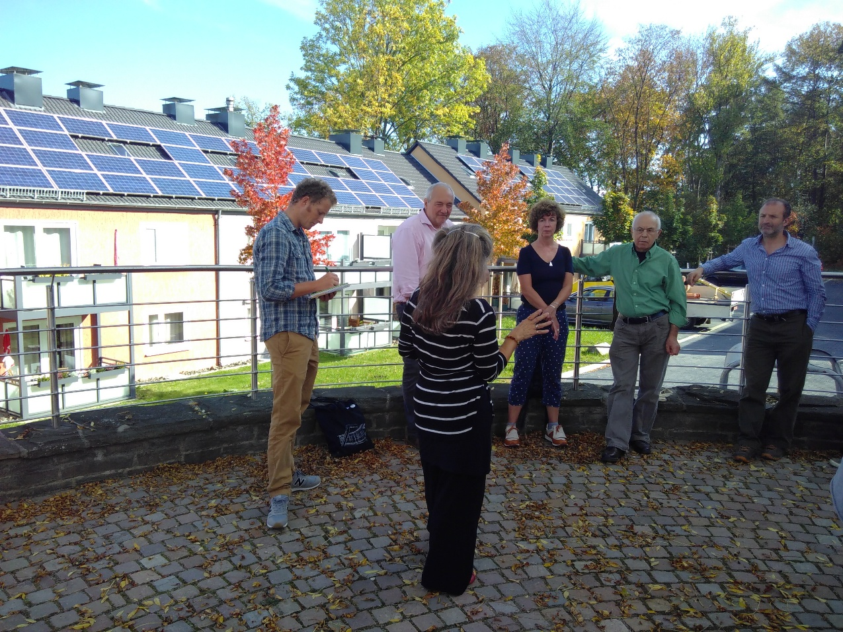
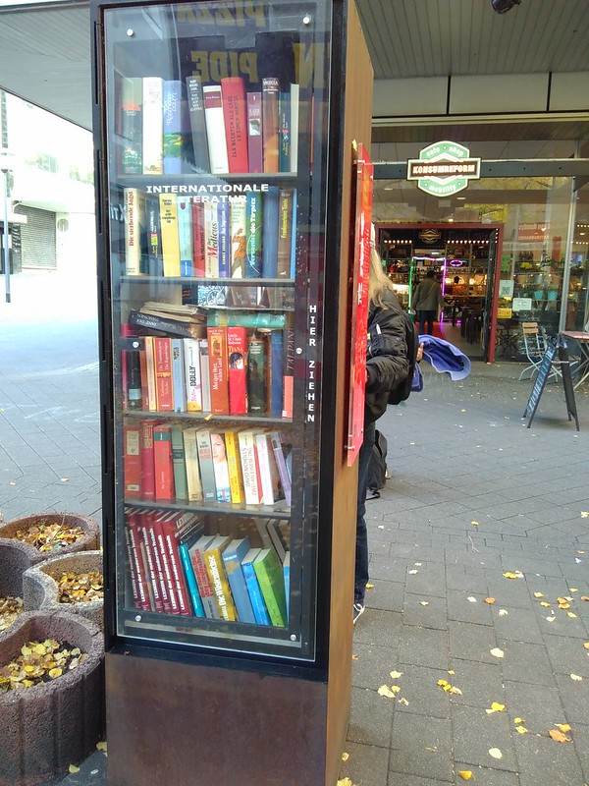
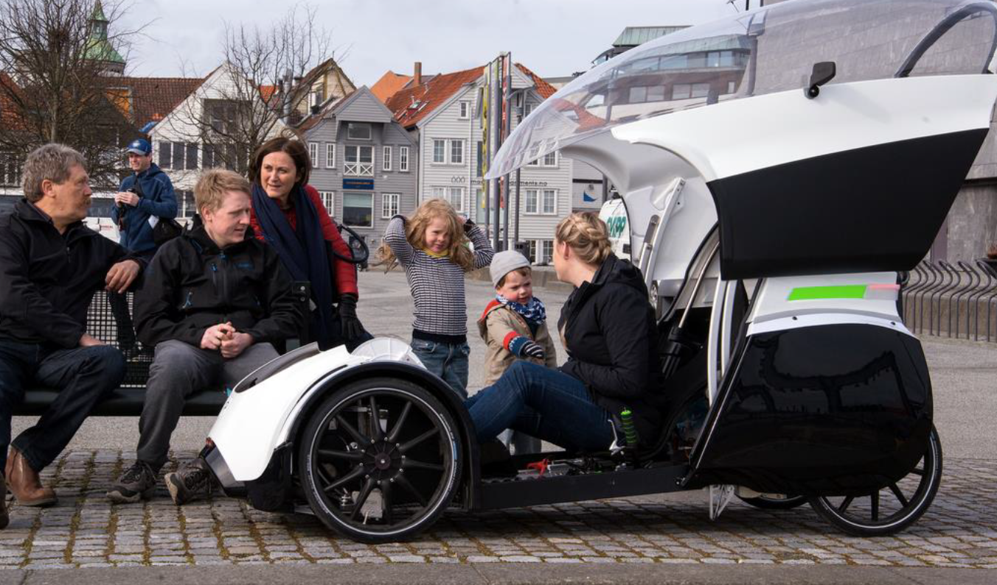
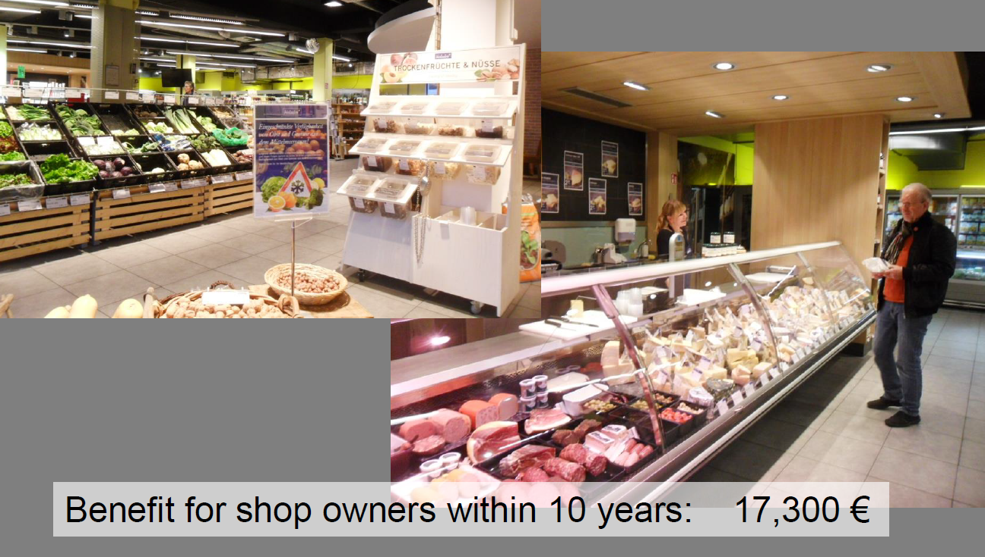
SOLAR CAFÉ EUROPA: ESSEN
Notes:
Guten Tag, liebe Freundinnen und Freunde. It is a real honour to speak with you today. I have visited Essen twice for EU projects and found enormous inspiration — in your cities, your community initiatives, and your cooperative tradition. Germany has deeply influenced the work we do in Sussex. Before I tell you what we do, let me explain the challenges we are facing in the UK:
Community energy remains tiny: 411 MW from 964 organisations — less than 1% of total UK generation.
Electricity prices among the highest in Europe, despite renewable energy now reaching 45–55% of the grid.
Prices remain tied to expensive gas, and consumers pay legacy “green levies” from early Feed-in Tariff schemes (sometimes over 50p/kWh).
Inequality is extreme:
6.5 million households in fuel poverty
£4.4 billion in energy debt
Winter deaths due to cold housing
Local councils going bankrupt across the country
The political climate is volatile; climate policy is at risk in the next election cycle.
Make the link explicit:
So the driver for community energy in the UK is not only climate. It is social justice, economic resilience, and community survival.

Slide 2




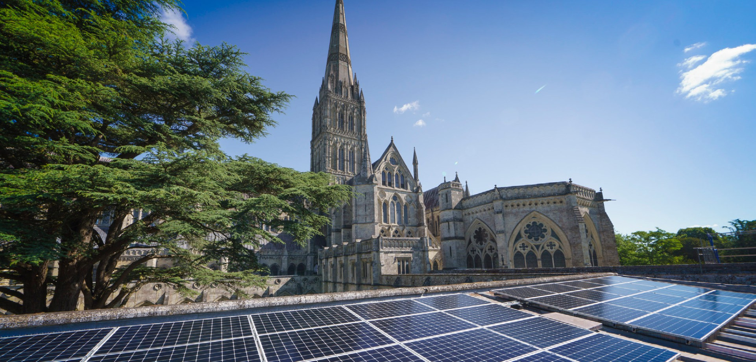

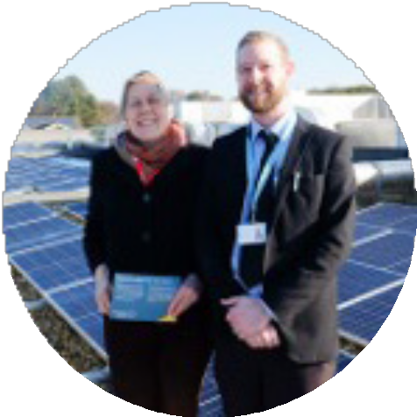
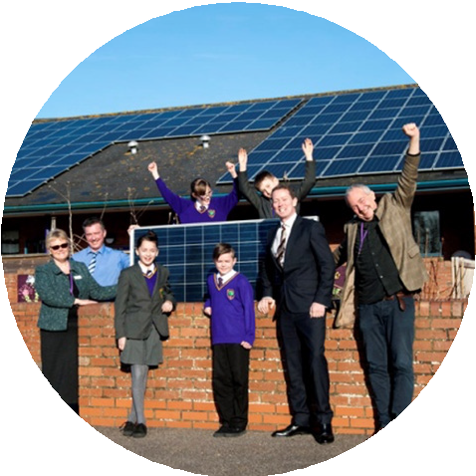
How does our business model work?
Community energy co-ops fund all the solar installation and maintenance
costs and charge sites only for the solar electricity they use, usually at around 50% less than the market price. All surplus goes for community benefit
Schools Energy Co-op
Free solar on 110 schools saving them £500,000 every year
Notes:
Introduce the three co-ops you co-founded:
Energise Sussex Coast – energy justice and fuel poverty
Schools Energy Co-op – solar on public buildings
Energise South – community-owned renewable generation — Schools Energy Co-op: Solar at Scale
(Use page 1 image and text from PDF )
Key points to say:
110 schools
4.5 MW installed
£500,000 annual savings for schools
Fully funded through community shares
Energy priced 50% below the market
All surplus goes back to community benefit
Message to German cooperative audience: This is an example of how a co-operative can operate at national scale while staying rooted in local benefit.

Slide 3
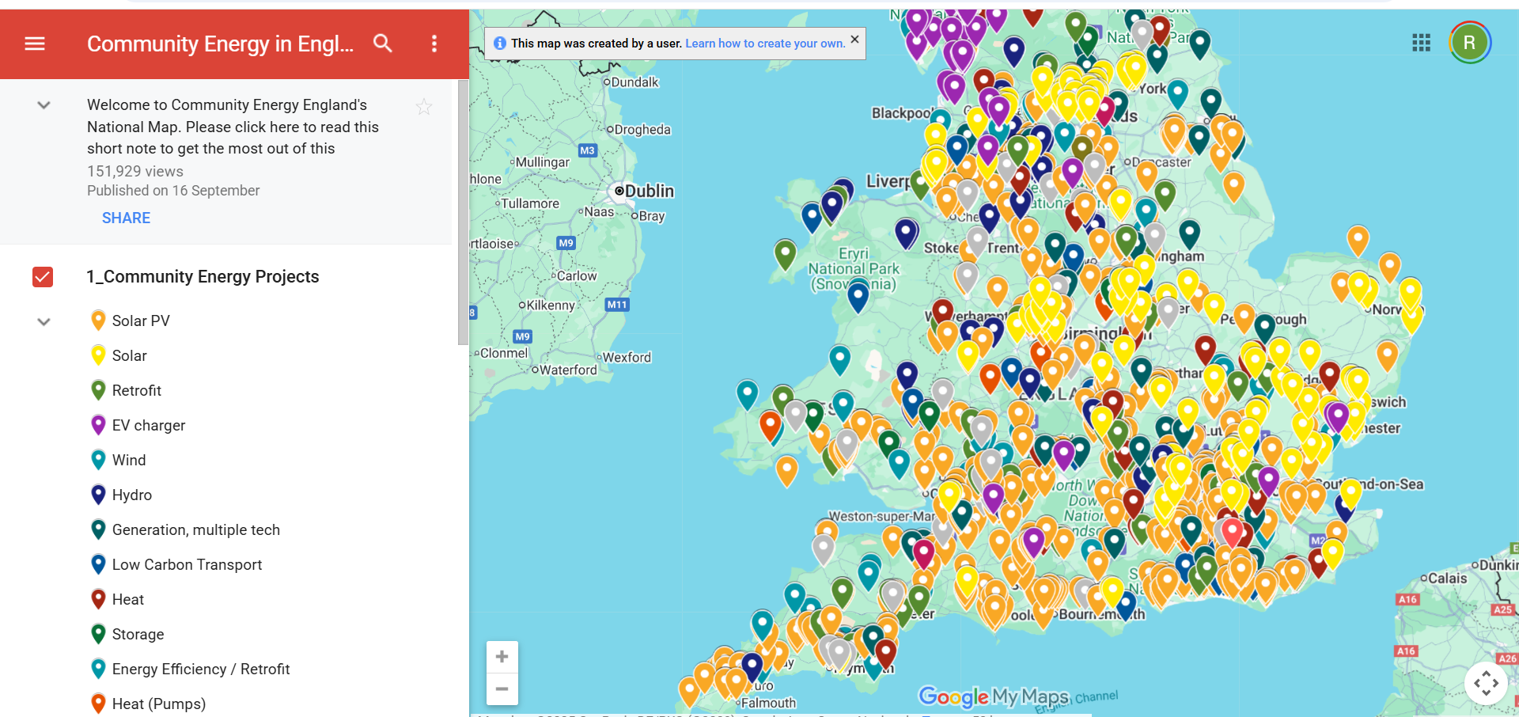
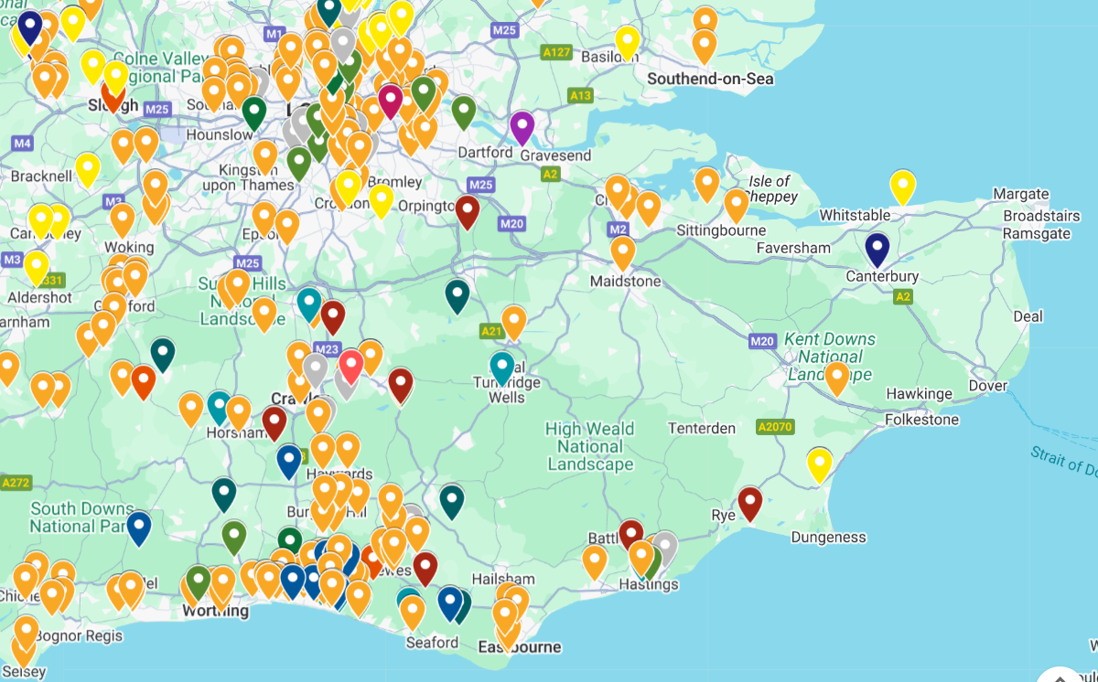
Notes:
Our Vision: Community Power in a Historic Landscape
Script:
We live in one of the oldest settled landscapes in Europe — a place built on pathways, commons, and cooperation for centuries. We believe the solutions to our crises — housing, energy, transport, food — lie in community ownership and in the landscape itself.
Give examples:
The pilgrims' routes — now becoming regional greenways
Historic villages ending in “-den”, shaped by seasonal movement and shared land
A region perfectly suited for eco-tourism, solar, and decentralised energy
This sets up the community energy narrative for German audiences, who understand regional identity + energy sovereignty. The area we are concerned with is the South East. I opened this map today and when I saw it I realised that we have not put in all our projects yet! A very important lesson for community energy – when someone is helping you to promote your work for free, make sure you actually give them the details!

Slide 4



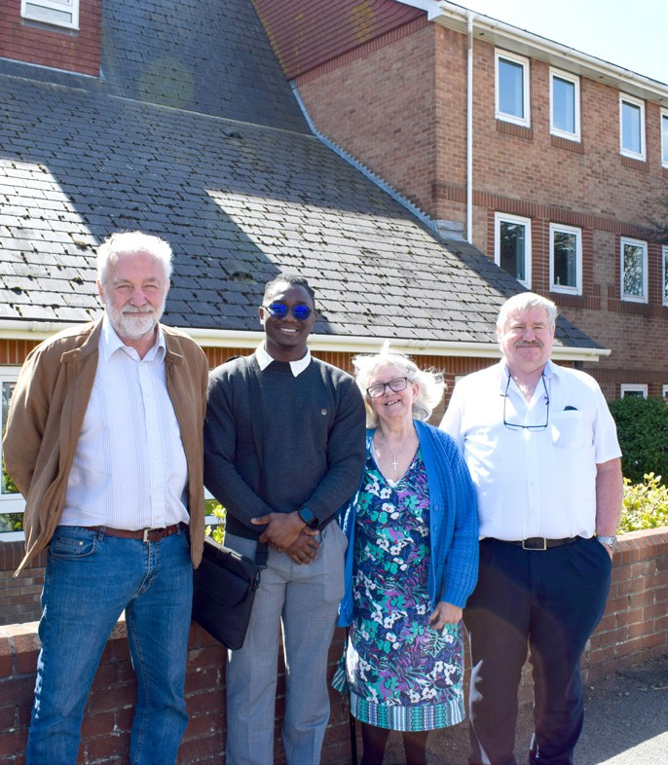
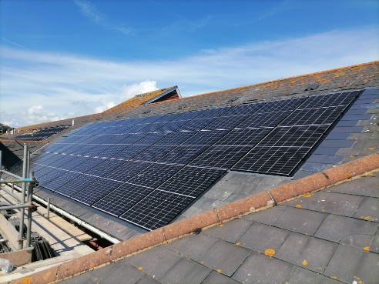
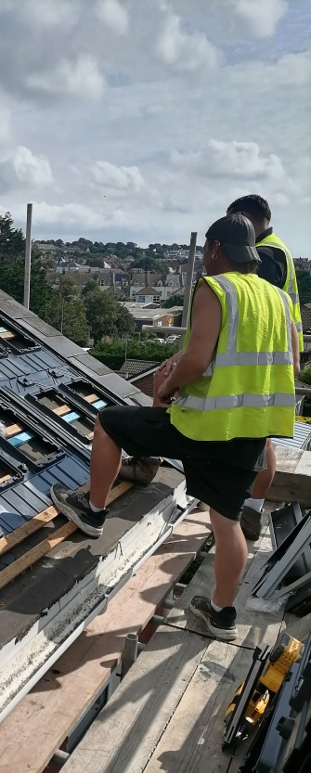
Community energy innovations
The Belmont is a solar retrofit of 36 sheltered flats
Residents save 51% on their energy costs per year
Management costs are halved
It is the first of its kind in the UK
E.ON delivered it with ECO4 funding – It won a National Energy Efficiency award
The solar was distributed equitably to 28 flats – Solshare was used – but there are several alternatives
We did 2 years of pro-bono work – the partnership with E.ON was the key,
And Len, the highly committed building manager
Notes:
Key messages:
36 sheltered flats, 51% savings for residents
Management costs halved
First of its kind in the UK
Community energy + E.ON partnership (interesting for a German audience)
Two years of pro bono community work → breakthrough project

Slide 5
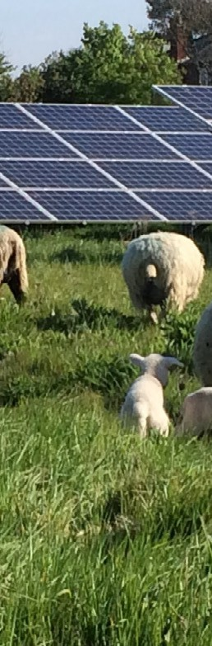


Crowhurst community solar farm
Planning consent took 800 days
It will be funded by community shares
The community energy model looks for a 6-7% Return
Members are reimbursed over 25 years with a 5% dividend
Any surplus will go to the community
Wildflower and tree planting will quadruple biodiversity
CPRE want to support this model
We will test a timber mounting frame
We could supply the railway next door with 55% of its electricity
A 5 MWh battery adds an easily replicable and versatile model
This is 10 ha of land. Every town or village could have one
Notes:
Crowhurst Community Solar Farm (5 MW)
Key points to highlight:
Planning took 800 days → perseverance is core to community energy
Entirely community-funded
25-year return with 5% dividend to members
Biodiversity increases (wildflower meadows, trees)
Potential to power the neighbouring railway
5 MWh battery → replicable model
A model for “Every village a solar village”

Slide 6
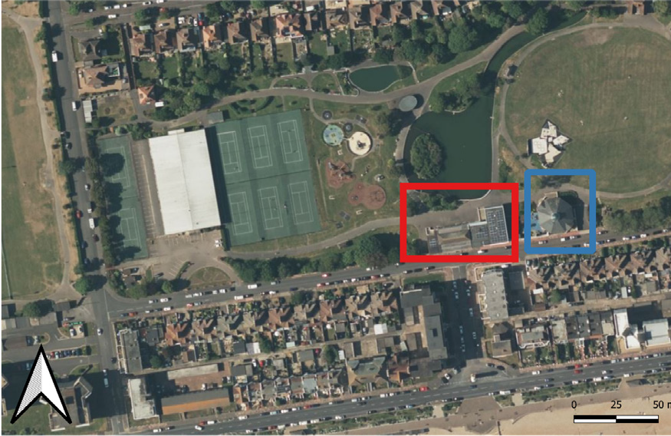
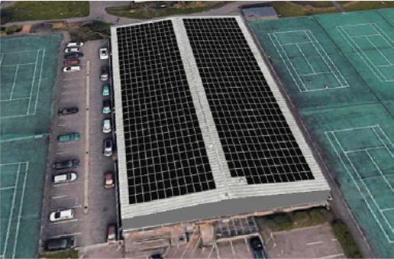
A neighbourhood microgrid
323 kW of PV on the indoor bowling club roof
Excess power to the Bexhill Museum and others via Private Wire
LED lights, a heat pump & AC system, and EV charging
275 kWh community battery
Zero cost to participants, a new roof cover and affordable solar cost, with 150 kW export limit
Sorting out the connection and 3-phase upgrade has taken a year
The LV and HV networks are very constrained. The key to this project are the partners
This is easily replicable across the town
Notes:
— Bexhill Microgrid: A Neighbourhood Energy System
Key points:
323 kW solar on bowls club roof
Excess electricity shared with museum and others
Heat pumps, EV charging, 275 kWh community battery
Zero cost to participants
Expected savings: £1.2 million + £120k community fund
Grid constraints → partnerships essential
Replicable across many UK towns

Slide 7
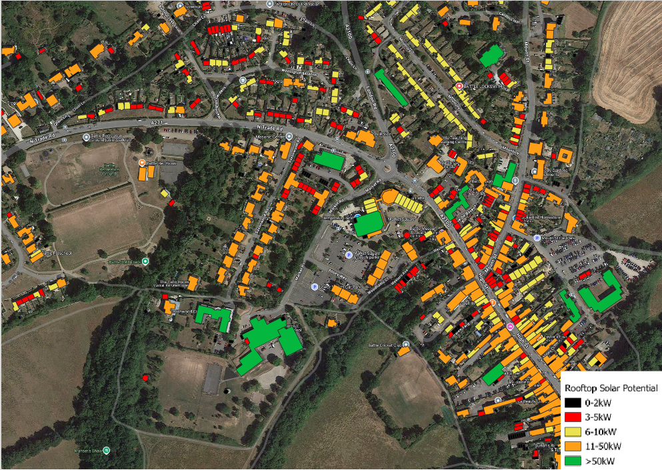
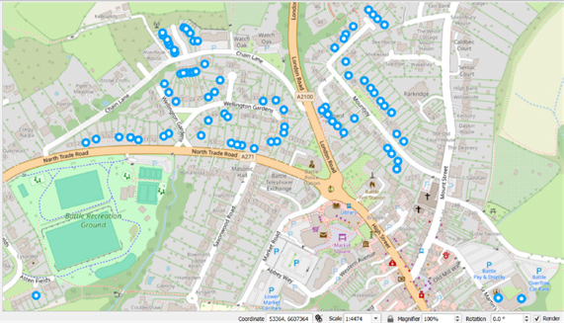
Battle solar town
Solar on 600 buildings generates 25% of the town’s electricity (4.41 MW)
ESC built a GIS solar mapping tool showing the solar capacity of every building
Key partnership with Southern Housing (375 homes)
Two large solar carports can supply local housing blocks
Key to this project is the local Battle Solar Town group
Converting the town hall into a resilience centre with PV + batteries + heat pumps in the theatre
Use of 5 MWh community green batteries would override grid constraints
Once proofed, the model could be replicated anywhere
Notes:
Battle Solar Town: 25% Local Energy
Script:
Solar on 600 buildings would generate a quarter of the town’s electricity.
GIS mapping shows every roof’s potential
Partnership with Southern Housing: 375 homes
Free solar & batteries for 200 new homes
Solar carports powering nearby blocks
Town hall becoming a resilience centre
5 MWh community batteries to relieve grid constraints
A model that could be replicated anywhere

Slide 8
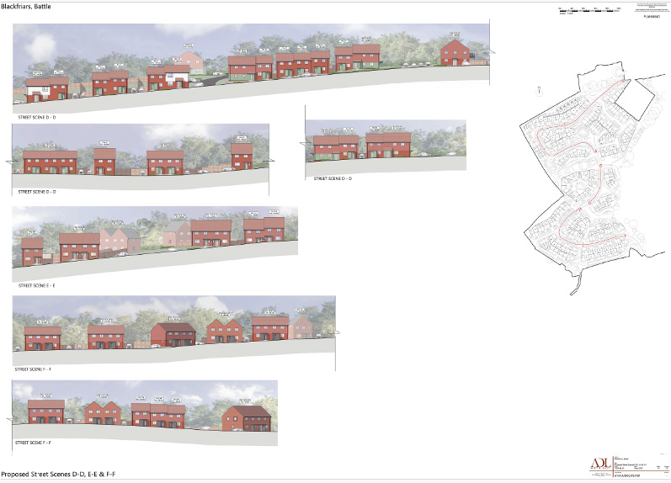

Zero bill new homes in Battle?
Free solar and battery for each home
Digital platform set up to use batteries and solar exports to balance the grid and supply the town
Any surplus income will be shared with residents
Phase 2: the model applied to Southern Housing
A First in the UK!
Notes:
Zero-Bill Homes
Key message:
Imagine homes where residents never receive an energy bill.
Free solar + battery
Digital platform balances grid & local use
Surplus income shared with residents
Phase 2 with Southern Housing
First in the UK

Slide 9
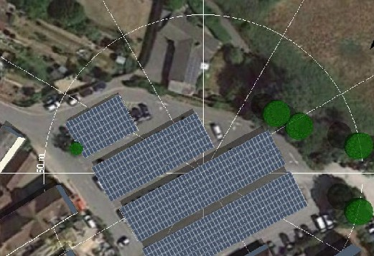

Solar Carports
We are partnered with Flexi-solar: building modular outdoor structures since 1991
Played a leading role in publishing BRE guidelines on solar carport design
Built the UK’s largest install at Bentley Motors in 2018 (2.8MWp)
Acquired by Aggreko in 2024; integrated into renewables division
Now offer the full range of PV: roof-mount, ground-mount, carports
Over 100MWp of installations plus extensive BESS experience (and EV charging)
Multiple carport designs - Lightweight vs heavyweight (and medium-weight!)
Focus with Energise Sussex Coast includes wooden frames, including local timber
EPC and PPA / funding options
Aggreko has £1bn+ invested globally in operational fleet, so happy to fund PPAs
Notes:
We are seeking partnerships with Global companies who recognise the value of community energy They are working on our finance model, and will deliver the projects…using a PPA price that works backwards from the basis that the end user will get a 25 % discount off the market price. They will make wooden structures because they can do this at scale. They interested in houses… These kinds of contacts and networks matter. Their market exposure is making them think differently.

Slide 10
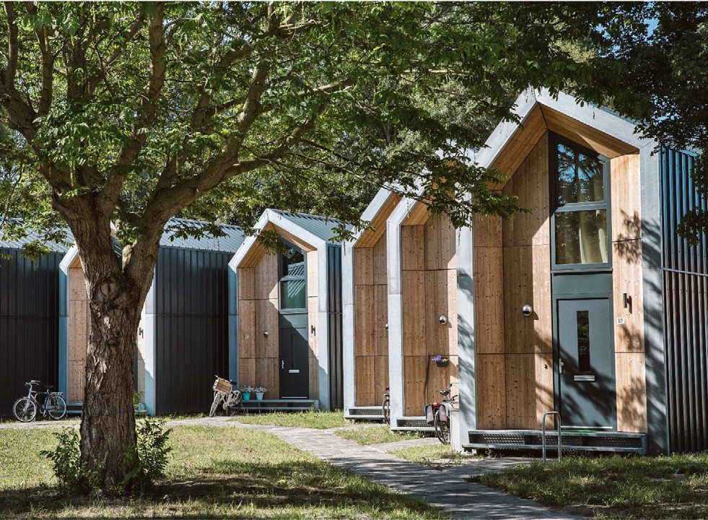
Future projects?
Affordable & transportable modular homes
Stijl homes based in Hastings
Dutch made, affordable, steel frame
Assembled or removed in a day
Temporary planning option
No foundations needed
Healthy green eco-homes
Generate up to 80% of own energy
Solution to housing crisis
Cost £129k for 1-bed, £ 185k for 2-bed
Ideal for flood risk areas and for affordable housing
Notes:
Future Vision: Affordable Modular Eco-Homes
Talking points:
Dutch modular homes — installed in a day
No foundations, suitable for flood zones
80% energy self-sufficient
A real solution for the UK housing crisis
We aim to build these through a community land trust

Slide 11
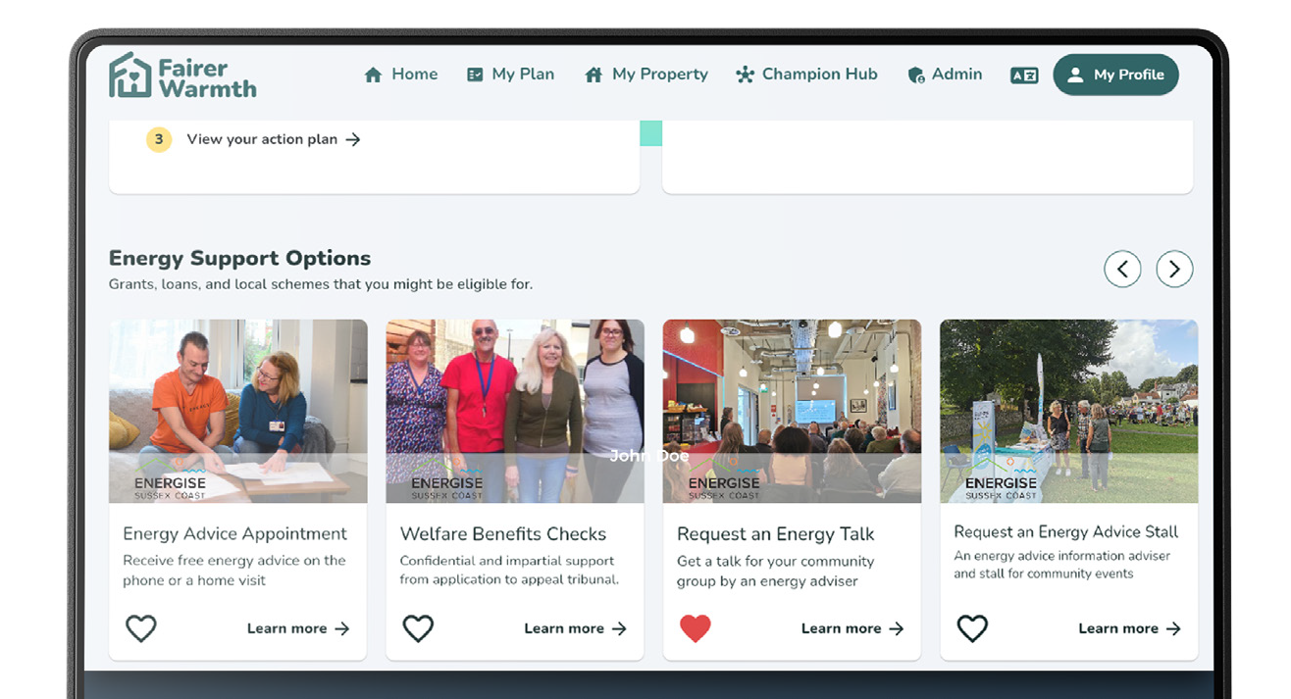
Fairer Warmth
A phone App and personalised energy platform that every resident can use
Energise Sussex Coast.
Our energy advice service held appointments with 9700 residents in 2024, saving them £450k at roughly £365 per household. We distributed
£90k of fuel vouchers.
84% of our clients are in fuel poverty and 72% have a disability. Two thirds rent.
Tackling energy inequality has always been our passion.
Notes:
Tackling Energy Poverty: Fairer Warmth Platform
Include:
9,700 residents supported in 2024
£450k savings
£90k fuel vouchers
84% in fuel poverty
72% disabled
Community energy must always include energy justice
This resonates strongly with German Genossenschaften values.

Slide 12





Contacts:
hello@energisesussexcoast.co.uk
Richard@energisesussexcoast.co.uk Tel 07854951325
01424 390062
www.energisesussexcoast.co.uk
Churchill@energisesussexcoast.co.uk Tel: 078 4397 2349
www.energisesouth.coop
Follow us online:
@energisesussex
EnergiseSussex
energisesussex
energise-sussex-coast
Energise Sussex Coast
Sign up to our monthly newsletter
Notes:
— Our Cooperative Model (Simple & Clear)
Script:
“We didn’t start with one big idea. We started with a simple cooperative rule: If the community needs it, we build it together.”
Explain:
A small co-op tackling fuel poverty
A second co-op to solarise schools → now one of the UK’s most successful
A third co-op scaling solar across the South East
Then:
All embedded in a national federation: Energy4All
20,000 members, £100m raised, 85 MW installed
This credibility unlocked opportunities (like negotiating with the solar farm landowner)
Mention REScoop.eu and their projection of 280 million Europeans in citizen energy communities by 2050. What We Believe
A good closing slide:
Local energy should stay local
Communities must own the transition
Decarbonisation and social justice are inseparable
Small co-ops can build big projects when they work together
The future is distributed, democratic, and cooperative

